Slide 1
Magnetic Storage System
Hard Disk Drive

Slide 2
Magnetic Storage
Magnetic storage or magnetic recording is the storage of data on a magnetized medium. It uses different patterns of magnetization in a magnetic material to store data.
It is in form of non-volatile memory.
The information is accessed using one or more read/write heads.

Slide 3
Classification of Magnetic Storage
There are different types of magnetic storage devices:
Hard Disk
Floppy
Tape
Lomega

Slide 4
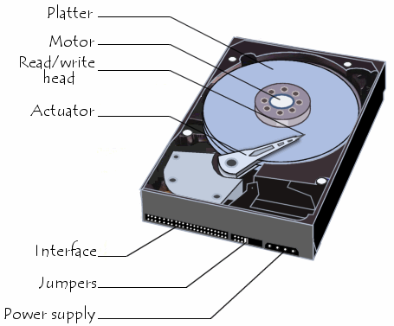
Hard Disk Drive
Hard disk are one or more rigid rapidly rotating disks “ Platters” coated with magnetic material.
It has different sizes of two diameters 5.25in and 3.5inch of disc. Although 2.5in and 1.75in are also available.
Two or more platters are stacked on a common shaft or spindle. Read/write heads on both side of the disk surfaces.
Actuator arm synchronizes all the read/write heads to keep them in perfect allignement

Slide 5
Read and Write Operation
Write: The direction or polarization of the magnetic domains on the disk surface is controlled by the direction of the magnetic flux lines produced by the write head according to the direction of a current pulse in the winding.
This magnetic flux magnetizes a small spot on the disk surface in the direction of the magnetic field.
A magnetized spot of one polarity represents a binary ‘1’ and opposite polarity represents binary ‘0’.

Slide 6
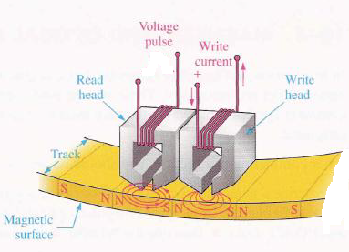
Read and Write Operation
Read: When passing through a read head the magnetized spot produce magnetic fields in the read head which includes voltage pulses in the winding.
The polarity of these pulses depends on the direction of the magnetized spot and indicates whether the stored bit is 1 or a 0.

Slide 7
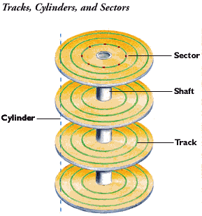
Hard Disk Formation
Hard disk is formatted into tracks and sectors.
Each track is divided into a number of sectors.
Each track and sector has a physical address that is used by the operating system to locate a particular data record.
The arrangements of tracks and sectors on a disk is known as format

Slide 8
Performance Analysis
A seek operation is the movement of the read/write head to the desired track. The seek time is the average time for this operation to be performed.
The Latency period is the time it takes for the desired sector to spin under the head position over the desired track.

